Slide 1
Leadership II for fire and ems: strategies for personal success managing multiple roles for the company officer

Slide 2
OBJECTIVES
The students will:
Prepare a personal role-set analysis.
Identify four levels of accountability.
Identify possible sources of role conflict for the Company Officer (CO).
Develop and apply a balancing strategy for resolving role conflicts.
Recognize the importance of the CO serving as a role model for subordinates.

Slide 3
OVERVIEW
Identifying and Prioritizing Multiple Roles
Role Expectations
Role Conflicts
The Company Officer as a Role Model
Accountability
The Leadership Role

Slide 4
Identifying and Prioritizing Multiple Roles
Definition:
  – A set of expected behaviors that characterize your part in a particular situation.
  – A function or office assumed by an individual.
Multiple roles:
  – We play many different roles daily.
  – Not unusual.

Slide 5
Identifying and Prioritizing Multiple Roles (cont'd)
Roles can be either formal or informal
Formal:
  – Inside the organization--station commander, lieutenant, paramedic
  – Outside the organization--parent, child, president of the PTA
Informal:
– Inside the organization--mentor, informal leader, "Godfather"
– Outside the organization--friend, neighbor, community activist

Slide 6
Identifying and Prioritizing Multiple Roles (cont'd)
Role-set analysis is the process in which an individual attempts to:
Identify all his/her roles (role set)
Prioritize multiple roles
Define role expectations
Identify existing or potential role conflicts
Develop balancing strategies to eliminate or reduce role conflicts

Slide 7
Identifying and Prioritizing Multiple Roles (cont'd)
Benefits of role-set analysis
Clarify own personal values
Understand others
Improves time management
Enhances your ability to be equitable and fair
Improves quality of your performance

Slide 8
Activity MR.1
Personal Role-Set Analysis
Identifying and Prioritizing Roles

Slide 10
Role Expectations
Definition:
  – How you are expected to act within a specific role
  – What's expected of you when you assume that role
Sources:
  – Key senders
  – Self expectations

Slide 11
Role Expectations
Role ambiguity
  – Unsure of what's expected of you
  – Key sender sends conflicting messages
Role ambiguity causes:
  – Stress, confusion, feelings of inadequacy, lack of direction
If unsure, seek clarification and open lines of communication

Slide 12
Activity MR.2
Personal Role-Set Analysis
Role Expectations

Slide 13
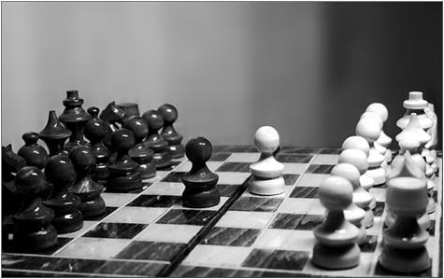
Role Conflicts
Intrarole conflict
Conflict within a specific role
Two types:
  – Your expectations versus key senders
  – Key sender versus key sender

Slide 14
Role Conflicts (cont'd)
Interrole conflict
Conflict between two or more separate roles
Two types:
– When an individual is expected to perform two or more different roles simultaneously
– When role priorities are out of balance

Slide 15

Role Conflicts (cont'd)
Interpersonal role conflict
A conflict between two or more individuals playing parallel roles
Examples: Two parents disagreeing about how children should be disciplined; two COs disagreeing about apparatus maintenance

Slide 16

Role Conflicts (cont'd)
What are some other examples of interpersonal role conflicts?

Slide 17
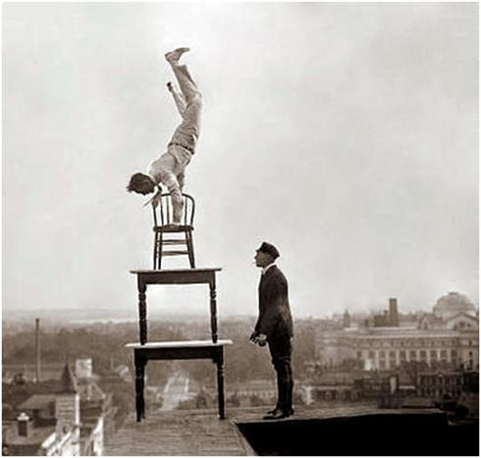
Role Conflicts (cont'd)
Balancing role conflicts
Inevitable.
Recognize serious conflicts.
Develop balancing strategies.
Most critical strategy is clearly delineating your priorities.

Slide 18
Role Conflicts (cont'd)
Intrarole priorities:
  – If there's a conflict between your expectations and a key sender's expectations, which has priority?
  – If there's a conflict between key senders, who is most important?
Interrole priorities:
  – Which role is more important?
  – The closer any role is to the "me" on the role-set analysis, the more important the role.

Slide 19
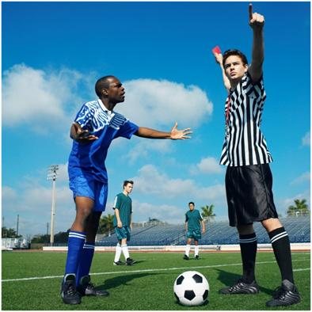
Role Conflicts (cont'd)
Interpersonal priorities
  – How important is the conflict issue?
  – Learn to accept and live with minor differences.
  – Resolve any critical differences?

Slide 20
Role Conflicts (cont'd)
Common characteristics of people who handle role conflict well:
Preference for taking initiative
Confidence and persuasiveness
Social poise, spontaneity, and talkativeness
Preference for flexibility
Strong desire to affiliate with people
Moderate desires for achievement and power

Slide 21
Role Conflicts (cont'd)
Ability to reach own conclusions
Rewards come from success
High priorities to planning and goal-setting
Lack of excessive feelings of pressure
In agreement with policies of department

Slide 22
Role Conflicts (cont'd)
What are some examples of people you know who seem to be especially good at handling role conflict?

Slide 23
Activity MR.3
Personal Role-Set Analysis Role Conflicts

Slide 24
The COMPaNY OFFICER As A Role Model
Responsibility to do best possible job with resources available.
  – Remember, your subordinates are watching you!
  – Your status as a CO means you are now a part of management and must support management positions.
  – This means becoming an effective role model--a person subordinates and peers can look up and emulate.

Slide 25
The COMPANY OFFICER As A Role Model (cont'd)
Becoming an effective role model means being professional.
  – Composite of personal skills and attitudes:
    -- Attitude.
    -- Behavior.
    -- Communication.
    -- Demeanor.
    -- Ethics.

Slide 26
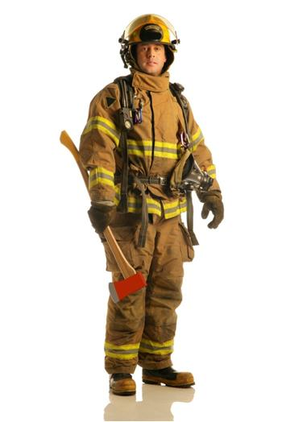
The COMPANY OFFICER As A Role Model (cont'd)
Attitude:
State of mind.
"Your attitude is showing!"
Reflected in appearance, attire, and adornments.
A positive attitude is contagious!

Slide 27
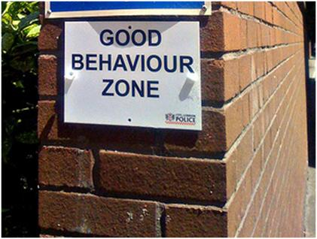
The COMPANY OFFICER As A Role Model (cont'd)
Behavior:
Behavior is how you act.
Influences your
subordinates.
Professional COs will:
  – Exercise self discipline.
  – Control emotions.
  – Exercise moderation and discretion off duty as well as on duty.

Slide 28

The COMPANY OFFICER As A Role Model (cont'd)
Communication:
How we get our message across
"People" business
Communication skills include:
  – Oral communication
  – Written communication
  – Nonverbal communication

Slide 29
The COMPANY OFFICER As A Role Model (cont'd)
Appearance
Behavior
Communication
Demeanor:
Sum total of A, B, and C.
Manageable.
Conscious awareness of problems in the area of appearance, behavior, and communication skills will enable us to work on eliminating these problems.

Slide 30
The COMPANY OFFICER As A Role Model (cont'd)
Ethics involve conforming to the standards of conduct for a given profession. Lack of ethics can destroy respect for a supervisor.

Slide 31
The COMPANY OFFICER As A Role Model (cont'd)
Other qualities of the supervisor as role model:
Enthusiasm
Initiative
Self-discipline
Courage
Integrity
Loyalty
Good judgment and decisiveness
Empathy
Discretion
Desire for self-improvement

Slide 32
The COMPANY OFFICER As A Role Model (cont'd)
Summary:
Professionalism in the form of "ABCDE" approach will help to ensure status as a professional.
The CO should always remember: "Your employees are watching you!"

Slide 33
Activity MR.4
Role Model Profile

Slide 34
Accountability
Four areas of accountability:
Accountability to self
Accountability to company
Accountability to organization
Accountability to public

Slide 35

Accountability (cont'd)
Accountability to self.
  – We are all accountable to ourselves first.
  – We must be able to live with our decisions.
    -- "What do you think of the person you see in the mirror?"
    -- We are often harder on ourselves than others are.

Slide 36
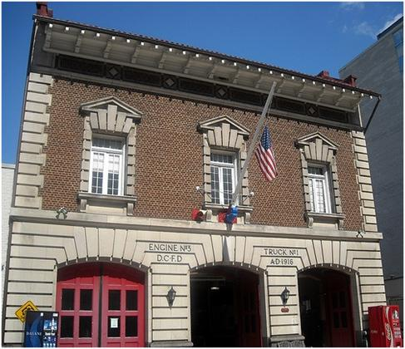
Accountability (cont'd)
Accountability to the company
Unique personalities and standards
  – "Norm" differs from company to company
  – Look out for personnel

Slide 37
Accountability (cont'd)
Accountability to the organization.
Formal (and informal) representative of management.
  – Blaming your "upper management" for your problems will generally come back to haunt you!
  – Your actions and professionalism as a CO can help to motivate others and ultimately, the organization itself.

Slide 38
Accountability (cont'd)
Accountability to the public.
Protect and serve the public.
  – Department mission must be carried out.
  – The more efficient and effective we are as the COs, the better the service we can provide.
  – The better our company can work together as a team, the better the job it will do on the fireground.

Slide 39
The Leadership Role
Leadership role functions
Things the organization expects you to do
Critical behaviors
Ten critical role functions fall into three categories:
– Interpersonal functions
– Informational functions
– Decisional functions

Slide 40
The Leadership Role (cont'd)
Interpersonal functions
Figurehead: the performance of ceremonial duties
  – CO at the annual awards ceremony
  – CO awarding prizes to elementary school children participating in a fire prevention poster contest

Slide 41
What are some other examples?

Slide 42
The Leadership Role (cont'd)
Leader: taking the direct actions typical of a leader; directing, ordering, counseling, disciplining, etc.
  – CO directing personnel on the emergency scene
  – CO conducting a counseling session

Slide 43
What are some other examples?

Slide 44
The Leadership Role (cont'd)
Liaison: making contacts with others, both inside and outside the organization (serving as a link)
– CO as a link between upper-level managers and company members.
– Officer setting up a drill on natural gas hazards with a representative of the local gas company

Slide 45
What are some other examples?

Slide 46
The Leadership Role (cont'd)
Informational functions
Monitor: scanning the environment for critical information; staying informed; keeping up with the times.
– CO "360s" the building during size up.
– Officer inspects site of a construction dig to ensure hole is properly shored.
– Keeping abreast with new technology
– Spotting trends.

Slide 47
What are some other examples?

Slide 48
The Leadership Role (cont'd)
Disseminator: giving out information others would not otherwise have
– CO holding a meeting with his/her personnel
– Officer acting as a coach with new recruit

Slide 49
What are some other examples?

Slide 50
The Leadership Role (cont'd)
Spokesperson: giving information to people outside of their unit or staff
– Officer addressing homeowner's association on the value of smoke detectors in the home
– CO serving as departmental Public Information Officer (PIO)
– CO notifying the chief of a critical company problem

Slide 51
What are some other examples?

Slide 52
The Leadership Role (cont'd)
Decisional functions
Entrepreneur: seeking to improve the unit by initiating creative or innovative changes
– CO designing new preplan form on computer
– Officer "commandeering" the use of heavy construction equipment to help control spill of hazardous materials

Slide 53
What are some other examples?

Slide 54
The Leadership Role (cont'd)
Disturbance handler: responding to unexpected conflicts
– CO dealing with an argument between two subordinates
– Officer dealing with an unruly crowd on the scene of an emergency incident

Slide 55
What are some other examples?

Slide 56
The Leadership Role (cont'd)
Resource allocator: deciding who will get what and do what
– CO assigning daily station maintenance.
– Officer assigning units to tactical positions on the scene of an emergency while serving as Incident Commander (IC)

Slide 57
What are some other examples?

Slide 58
The Leadership Role (cont'd)
Negotiator: settling issues and resolving conflicts
– CO dealing with the first step of a union grievance
– Officer serving as member of a task group containing wide representation from various segments of the community

Slide 59
What are some other examples?

Slide 60
Activity MR.5
Developing Balancing
Strategies

Slide 61
Summary
In order to be a successful manager, the CO must manage a variety of roles, both inside and outside the organization.
Role conflicts are an inevitable fact of organizational life; it is up to the individual manager to understand the conflicts and apply the proper balancing strategy.
The CO must be able to apply balancing strategies to function effectively in the various positions.

Slide 62
Summary (cont'd)
Four areas of accountability for the CO include accountability to self, to the company, to the organization, and to the public.
As a role model, the CO should always remember: "Your subordinates are watching you!"

